Slide 1
The memory hierarchy
IT 301

Slide 2
The memory hierarchy
CPU
Registers
Processor Caches
Main Memory
Secondary Memory (HDD, SSD)
Why does my program
slow down when I access
a file?
Where is my program
stored during execution?
Do I need to consider
the size of memory on
a computer that runs my
program?
Why does my program
run slower when I access
data from my database
server?
Can memory size
ever be a bottleneck
in my program?
Will buying an SSD
drive speed up my
programs?

Slide 3
Types of Memory
The Memory Hierarchy

Slide 4


Volatility
Volatile memory:
Values stored in memory are maintained only while the computer is powered on
Non-volatile memory:
Values stored in memory are maintained while the computer is powered on or off

Slide 5
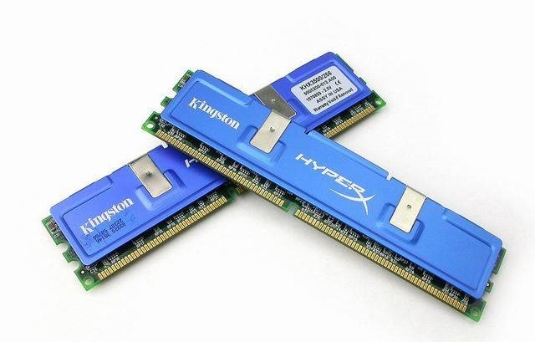
Random access memory
RAM (random access memory): accessing any memory location to be takes roughly the same amount time
Dynamic RAM (DRAM)
A single memory cell:
Holds 1 bit of information
Contains a single transistor and capacitor
Requires a refresh operation to maintain its information
This has a negative effect on the performance of the RAM
Static RAM (SRAM)
A single memory cell:
Holds 1 bit of information
Requires 4-6 transistors
Does not have a refresh operation
Significantly quicker than DRAM
More expensive than DRAM
Notes:
A transistor is a semiconductor device used to amplify and switch electronic signals and electrical power.
A capacitor is a passive two-terminal electrical component used to store electrical energy temporarily in an electric field.

Slide 6
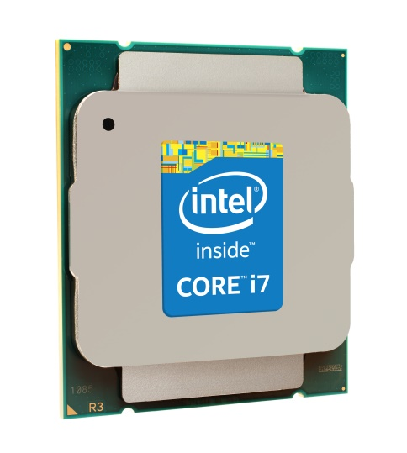
Registers
Processor registers
Used to hold data values before and after processor execution
Attributes
Very small capacity
Very fast access speeds
Very expensive
Volatile
Directly influenced by the architecture of the processor

Slide 7
Cache memory
Processor caches
Small segment of memory used to store values the processor is likely to use next
Attributes
Very small capacity
Very fast access speeds
Very expensive
Volatile
A processor will typically have several caches that are used to improve performance (more on this later)

Slide 8
Main memory
Main memory
Also called primary memory, this memory is used to store your OS, programs and data files while in use
Attributes
Medium capacity
Fast access speeds
Affordable
Volatile
Almost all modern computers use Dynamic RAM (DDR) for main memory

Slide 9
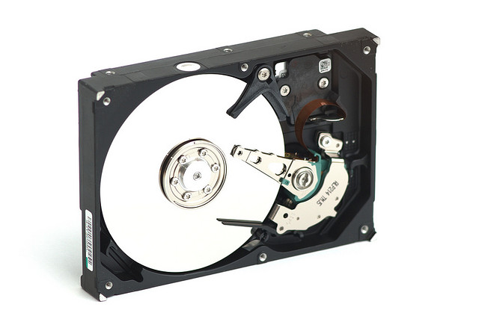
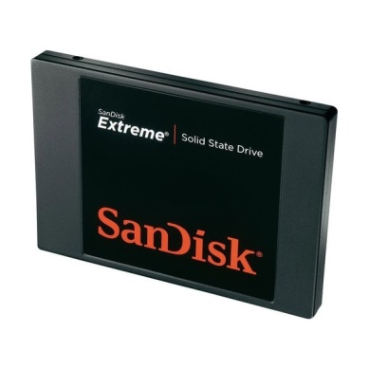
Secondary memory
Hard disk drive
Solid state drive
Medium term storage for your OS, programs and data files while not in use
Attributes
Very large capacity
Slow access speeds
Very cheap
Non-volatile
Medium term storage for your OS, programs and data files while not in use
Attributes
Large capacity
Slower access speeds
Cost varies
Non-volatile

Slide 10
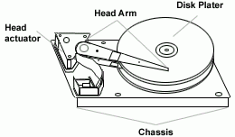
Secondary memory
Hard disk drive
Solid state drive
Several magnetic disks
Disks are arranged in a spindle
Increased seek time with actuator
Primarily uses flash memory technology
No moving parts
Lower access times

Slide 11
Other types of memory
Tape storage
Long term storage using magnetic tape
Attributes
Very large capacity
Very slow access speeds
Affordable
Non-volatile
Network resources
These include cloud storage, network drives, FTP/HTTP resources

Slide 12
Memory access times
~1,000,000x slower
~100x slower

Slide 13
Memory access times

Slide 14
Memory access times

Slide 15
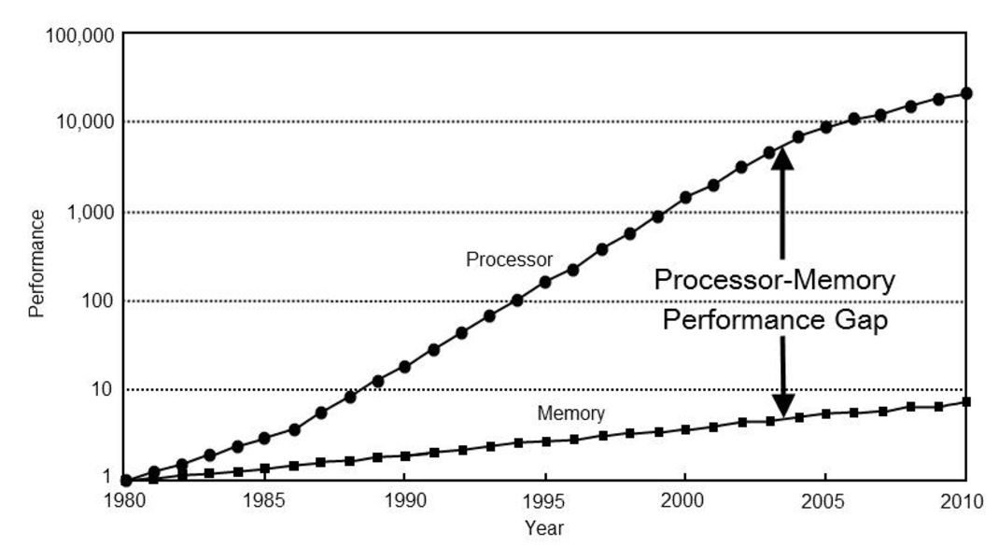
The memory hierarchy
CPU speeds have historically outpaced memory speeds
You can have
Fast, small and expensive memory
Slow, large and in-expensive memory
The goal: have unlimited, fast, large capacity and reasonably priced memory

Slide 16
The Memory Hierarchy
The Memory Hierarchy

Slide 17
The memory hierarchy
Create a tiered hierarchy of memory
Transfer instructions
and data into
registers for
processing.
Load instructions
and data into
fast cache memory
Load program
into memory
Hard disk drive
Main Memory
Processor cache
Processor registers

Slide 18
The memory hierarchy
What are the benefits? What are the challenges?
Speed
Hard disk drive
Main Memory
Cache
Registers
Space
Program Instructions
and Data

Slide 19
Cache Memory
The Memory Hierarchy

Slide 20
Cache Design
Goals
Challenges
Have all instructions pulled from fast cache memory
Treat our memory as if
capacity is the size of our largest memory (HDD)
speed is the same as fast cache memory
We cannot load every instruction into cache memory
It is costly time-wise to transfer instructions between memory tiers
We want to keep instructions in cache memory that will be reused in the future

Slide 21
Principles of locality
Can we anticipate what entries should be loaded into a cache and those that should remain in the cache?
Principles of locality
Temporal locality: instructions that have recently been executed are likely to be executed again
Iterations in a loop!
Repeated function calls!
Spatial locality: instructions near recently executed instructions are likely to be executed
Program instructions are often side-by-side in non-fragmented memory

Slide 22
Cache levels
There are typically several tiers of caches
Each tier is faster, smaller and more expensive the closer it is to a processor
L1 cache:
Integrated with a CPU core
~64KB (2015)
L2 cache:
Larger and slower than L1 cache
Integrated into a CPU core or shared among multiple cores
~256KB (2015)
L3 cache:
Larger and slower than L2 cache
Shared between all CPU cores
~4-8MB (2015)
Main Memory
L3 Cache
L2 Cache
L1 Cache
Processor Registers
Processor

Slide 23
Caching terminology
Cache line (block): a group of memory values that is transferred to/from the cache
Hit/miss:
A hit occurs when an instruction is requested and found in a cache
A miss is when an instruction is requested but not found
Hit rate: The ratio of hits to total requests.
Miss rate: 1 – hit rate
Hit time: The response time for hits
Miss penalty: The time it takes to retrieve a cache line from a lower level in the memory hierarchy

Slide 24
Requesting data from cache memory
Request a memory address
Is the address in cache memory?
If so, return the data in cache memory (a hit)
If not, make a request for a cache update (a miss)
Cache updates are passed on to the next level of the memory hierarchy

Slide 25
Scenarios
Ideal scenario
Processor requests cache line A1 from cache memory
A1 is in cache memory
Load instruction
into register!
Processor
request
for A1
Cache
hit!
Main Memory
L3 Cache
L2 Cache
L1 Cache
Processor Registers
Processor

Slide 26
Scenarios
Processor requests cache line A1 from cache memory
A1 is not in L1 cache
L1cache makes a request for an update to lower level cache
Load cache line
into L1 cache!
Load instruction
into register!
Request
for A1
Processor
request
for A1
Cache
miss!
Main Memory
L3 Cache
L2 Cache
L1 Cache
Processor Registers
Processor

Slide 27
Scenarios
Requests for a memory address may continue through several layers of caches
Important: each cache only interacts with the tier above and below it
Cache
miss!
Cache
miss!
Cache
miss!
Processor
request
for A1
Main Memory
L3 Cache
L2 Cache
L1 Cache
Processor Registers
Processor

Slide 28
Cache techniques
Associative
Set Associative
Direct Mapped

Slide 29
Direct mapped caches
Assume that a memory address in a system has d bits
Main memory can then address 2^{d} locations
Address | Data
0
2^{d}-1

Slide 30
Direct mapped caches
Caches load groups of addresses called blocks
Assume you have b bits to differentiate any data location in a block
The number of memory locations in a block is 2^{b}
Address | Data | Block address
0 |  | 0
 |  | 1
 |  | 2
 |  | 3
 | …
 | …
2^{d}-1 |  | 2^{d}/2^{b}-1

Slide 31
Direct mapped caches
Word bits: the rightmost b bits used to identify the location of a word in a block
Address | Data | Block address
0000 |  | 00
0001 |  | 01
0010 |  | 10
0011 |  | 11
0100 |  | 00
0101 |  | 01
0110 |  | 10
0111 |  | 11
 | …
Word
word bits
b bits

Slide 32
Direct mapped caches
Blocks are transferred to a cache when a word within the block is requested
Direct mapped caches use the following calculation to determine where to place a block
address % cache size
This calculation is trivial assuming the cache size is a power of 2
For example, 2^{c}, where c is a positive integer
Our calculation would then be: address % 2^{c}

Slide 33
Direct mapped caches
Cache Address | Block Data
00
01
10
11
Address | Data
0000xx
0001xx
0010xx
0011xx
0100xx
0101xx
0110xx
0111xx
1000xx
1001xx
1010xx
1011xx
1100xx
1101xx
1110xx
1111xx
Word
cache bits
word bits
c bits
b bits

Slide 34
Direct mapped caches
Tag | Block Data
01 |  | 1
 |  | 0
11 |  | 1
00 |  | 1
Address | Data
0000xx
0001xx
0010xx
0011xx
0100xx
0101xx
0110xx
0111xx
1000xx
1001xx
1010xx
1011xx
1100xx
1101xx
1110xx
1111xx
Valid
Word
tag bits
cache bits
word bits
d-c-b bits
c bits
b bits

Slide 35
Direct mapped caches
Tag | Block Data
01 |  | 1
 |  | 0
11 |  | 1
01 |  | 1
Address | Data
0000xx
0001xx
0010xx
0011xx
0100xx
0101xx
0110xx
0111xx
1000xx
1001xx
1010xx
1011xx
1100xx
1101xx
1110xx
1111xx
Valid
Tag bits are use to identify
which block was placed in the cache.
Valid bit is used to denote
whether a cache-line should or should no be used.

Slide 36
Fully associative caches
With direct mapped caches a block is always mapped to one position
Associative caches relax this condition
A block can be placed in any cache location
Address | Data
0000xx
0001xx
0010xx
0011xx
0100xx
0101xx
0110xx
0111xx
1000xx
1001xx
1010xx
1011xx
1100xx
1101xx
1110xx
1111xx
Valid
Tag | Block Data
1001 |  | 1
0010 |  | 0
1111 |  | 1
1100 |  | 0
1000 |  | 0
1011 |  | 1

Slide 37
Fully associative caches
Address | Data
0000xx
0001xx
0010xx
0011xx
0100xx
0101xx
0110xx
0111xx
1000xx
1001xx
1010xx
1011xx
1100xx
1101xx
1110xx
1111xx
Word
tag bits
word bits
d-b bits
b bits
Valid
Tag | Block Data
1001 |  | 1
0010 |  | 0
1111 |  | 1
1100 |  | 0
1000 |  | 0
1011 |  | 1

Slide 38
Benefits/drawbacks?
Tag | Block Data
01 |  | 1
 |  | 0
11 |  | 1
 |  | 0
 |  | 0
10 |  | 1
Valid
Increase hit rate
by avoiding
unused cache
lines

Slide 39
Benefits/drawbacks?
Valid
Tag | Block Data
1001 |  | 1
0010 |  | 0
1111 |  | 1
1100 |  | 0
1000 |  | 0
1011 |  | 1
Searching for a block means
comparing a tag against
all tags in the cache.
The implementation of
the cache is more
complex/expensive.

Slide 40
Set associative caches
A mixture between direct mapped caching and fully associative caching
We group together memory blocks into sets (groups)
A memory block can only belong to one set
We use associative mapping to place and search for elements in a set
Word
tag bits
set bits
word bits
d-s-b bits
s bits
b bits

Slide 41
Set associative caches
Set bits are first used to determine which set a memory block belongs to
Address | Data
0000xx
0001xx
0010xx
0011xx
0100xx
0101xx
0110xx
0111xx
1000xx
1001xx
1010xx
1011xx
1100xx
1101xx
1110xx
1111xx
Set Bits | Set Blocks
00
01
 | …

Slide 42
Benefits/drawbacks?
Reduces the size of any associative group
This reduces the complexity of simultaneous lookups in a set
Higher hit rate due to associative placement in sets
Flexible placement in sets

Slide 43
Virtual Memory
The Memory Hierarchy

Slide 44
Virtual memory
Technique for creating a larger memory space than that provided by main memory (RAM)
Combines main memory and secondary memory into a single virtual memory space for a process
Physical addresses are mapped to virtual addresses
Main Memory
Secondary Memory
Virtual Memory

Slide 45
Terminology
Pages: a group of memory addresses that are accessed all at once
Paging: the process of temporarily moving pages from main memory to secondary memory (HDD)
This happens when main memory is full
Pages are stored temporarily until they are referenced next, after which they are transferred back into main memory

Slide 46
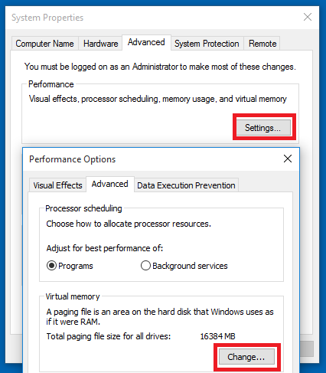
Terminology
Page/swap file: the location in secondary memory where pages are stored
Memory manager unit (MMU): handles caching and paging for a processor

Slide 47
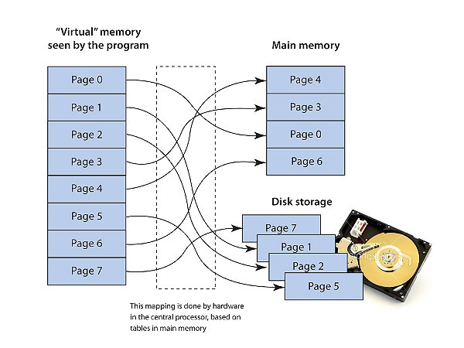
Paging

Slide 48
Benefits?
Security: each process is given its own virtual memory space, which is sequestered from other processors
Limits of main memory: this allows a program that could not normally fit in main memory to run
Note: this was a larger problem in the memory-starved 1990s
Note: many real world programs will not fit in main memory on any standard machine

Slide 49
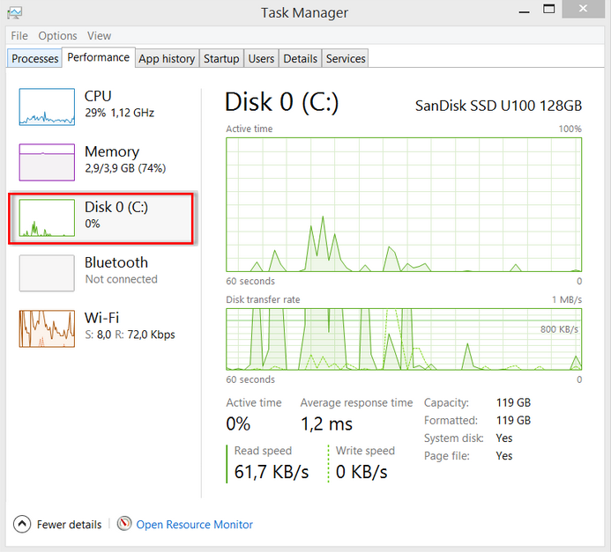
Thrashing
Thrashing is a where
main memory is full
there is constant paging occurring
pages are repeatedly being pulled into main memory, then replaced again
This is a symptom of
too much memory is in use from running programs
limited memory resources on a machine

Slide 50

Final thoughts
Be aware when your program is
accessing secondary memory
opening a file
interacting with a database
connecting with resources over a network
HTTP connections
web services
network drives
FTP
Be aware of how much memory your program is using!

Slide 51
The memory hierarchy
IT 301

